Slide 1

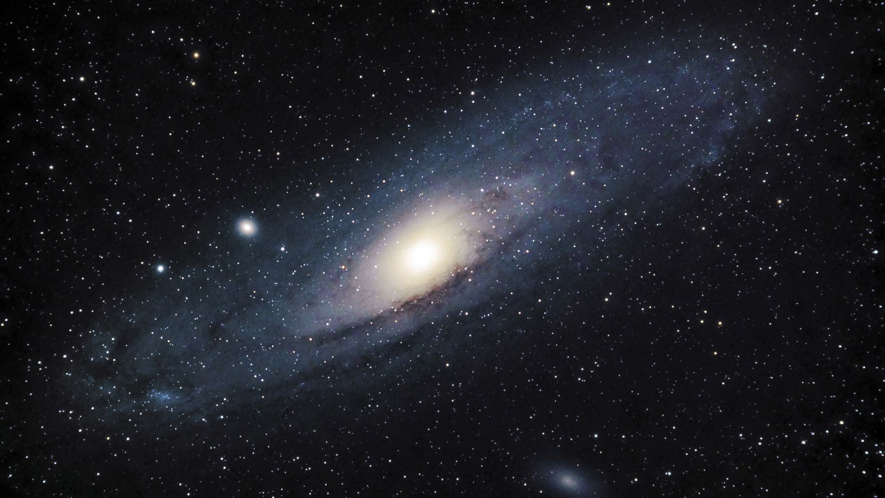
Capstone Comet Photometry
Will Leija, Marco Baca

Slide 2
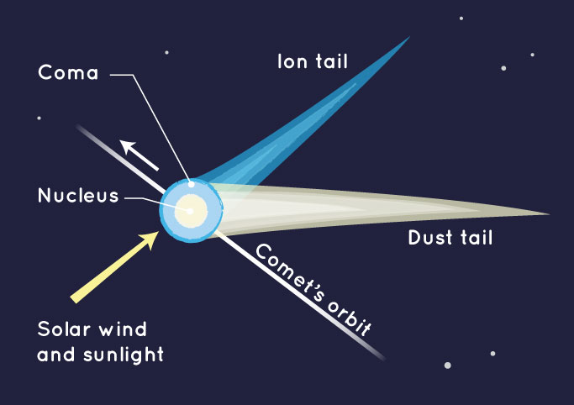
Background on Comets
Comets are cosmic snowballs of frozen gases, rock, and dust that orbit the Sun.
They are formed from dust, rock, and ice leftovers from solar system formation.
When a comet's orbit brings it close to the Sun, it heats up and spews dust and gases into a giant glowing head larger than most planets.
The dust and gases form a tail that stretches away from the Sun for millions of miles.
The components of a comet include:
Nucleus - Made of ice and rocky materials
Coma – The cloud of gases around the nucleus
Dust Tail – Gases and dust blown away from the nucleus when heated
Ion Tail – A stream of gases blown away from the sun due to solar wind

Slide 3
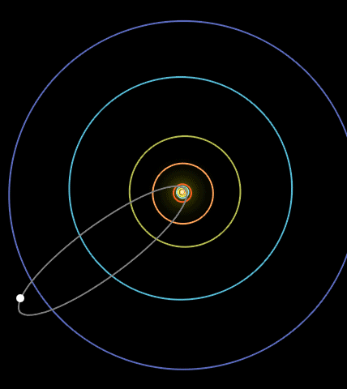
Halley's Comet
The first comet that was known to be periodic which is visible every 75-76 years. It's the only periodic comet that can be seen by the human eye.
The tail of the comet can get up to 62,000 miles long while the nucleus is 15 kilometers long, 8 kilometers wide, and about 8 kilometers thick.
The gases released by the nucleus are mostly water vapor with some carbon monoxide and a bit of carbon dioxide

Slide 4
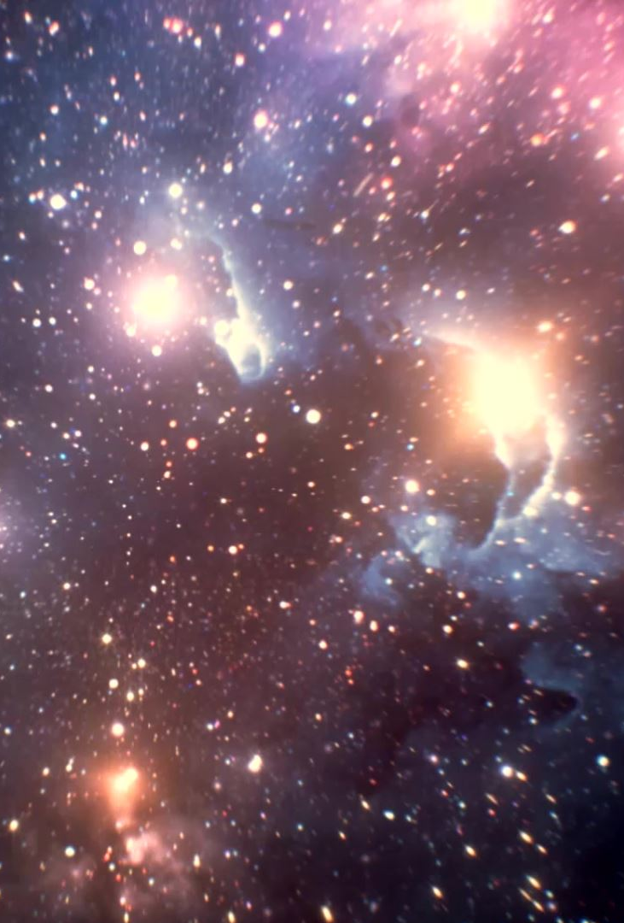
Photometry
The measurement of the brightness of the star.
- When measuring the star's brightness, we need a measured object (usually a star) and then a reference star.
Ex. If an image is taken for a 16 bit: the max will be 65,000 ADU so if the image is 20,000-40,000 ADU, that is good. It is far from the noise of the image & below saturation. It will be clear enough for data.

Slide 5
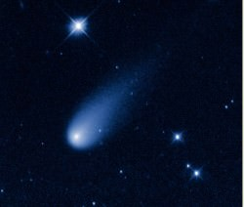
Problems With Comet Photometry
1) There are problems with the proper subtraction of non-comet light (so the background, contribution from stars near or within the coma, etc.).: When a comet approaches the Earth, its light may appear spread out over a large area. How can we now compare the light from the comet to that from a comparison star?
2) To measure a physically meaningful amount of light from the comet. Unfortunately, no two comets are alike. Issues with integration over time since the comet moves over time (so that different reference stars are usually needed every night).
This Photo by Unknown author is licensed under CC BY.

Slide 6
Problems With Comet Photometry In Our Code
-The fits image of Halley's comet has a tail which disrupts true background values that would be subtracted from the actual aperture count.
- Difficult to pick an actual aperture size since we don't know where exactly the nucleus is as the coma can interfere.
-We have to compare the magnitude of the comet at different times to get a good approximation.

Slide 7
Our Photometry Code and Results
Open up Code

Slide 8
Conclusion From Our Photometry Method
Picking the center points for the aperture was difficult, on the image they all looked to be the same, but from our results you can notice the centers used might not have been appropriate. (Mean background dropped continuously.)
Our method presented as one would predict, an increase in brightness of the aperture for each source compared to the original method.
Method still seems to be ineffective as it doesn't solve the other problems when facing comet photometry like the interference of the coma and it doesn't use a reference source.

Slide 9
Applications of Comet Photometry
Such measurements can yield large amounts of information on the objects' structure, temperature, distance, age, etc.
- Temperature: Measure the brightness of a star through two filters and compare the ratio of red to blue light.
- Age: find your B-V indices, correct for interstellar reddening and extinction and atmospheric absorption, H-R diagram w/ absolute magnitudes, make your Bolometric Correction, find the Luminosity at the Turnoff Point, and then you can calculate the age of the cluster in terms of Solar Life Expectancies.

Slide 10
Photometry on Halley's Comet
A group of astronomers in 1982 in the "Observatorio Astrofisico and Instituto di Astronomia" lab in Catania Italy performed photometry on Halley's comet and this is what they found.
Composition of Halley's comet includes water, methane, and Carbon dioxide.
Trace evidence of presence of lighter elements in the dust found at the tail of the comet.
Low albedo due to the organic nature of the mantle and dust.
They used photometry to learn about the properties of the comet.

Slide 11
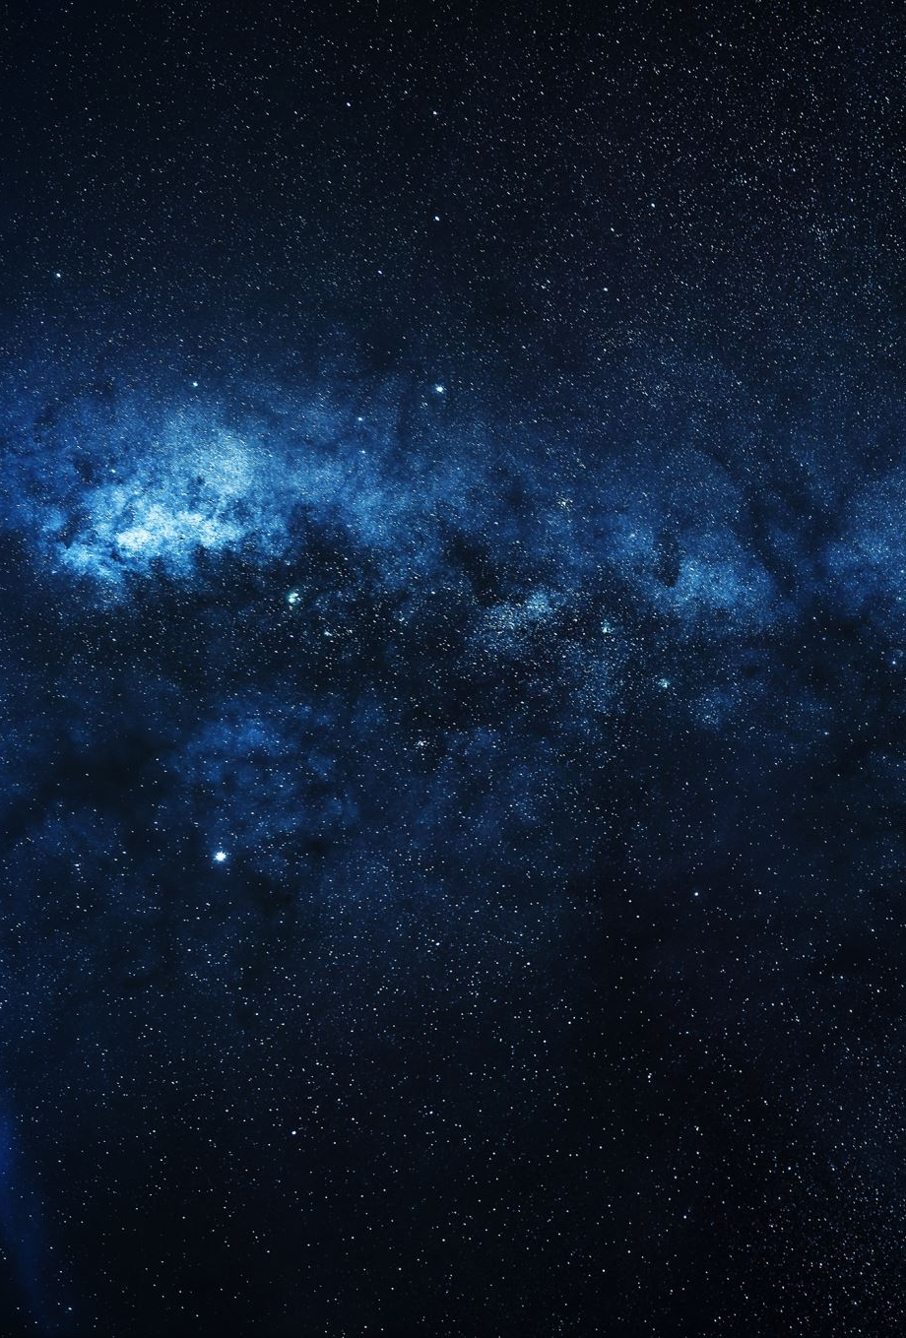
Why Comets?
Showcase the difference in photometry.
- Photometry is the same goal but changes when comparing stellar objects (stars vs comets). It involves more attention to detail and more difficulty to perform than the photometry we did in class, and it is important to know that one simple science has many different types.
Allowed us to practice our skills we developed (coding, DS9) and use it for a topic we both enjoy.
This is a topic that could be explored in independent research (deeper research w/ spectroscopy,etc..) , find a mentor for research with comet astronomy, or even recommend for next spring when this class is taught.

Slide 12
Citations
Mobberley, M. (2011). Comet Photometry. In: Hunting and Imaging Comets. Patrick Moore's Practical Astronomy Series. Springer, New York, NY. https://doi.org/10.1007/978-1-4419-6905-7_14
“CCD Photometry of Comets.” Www.icq.eps.harvard.edu, www.icq.eps.harvard.edu/CCDmags.html. Accessed 10 May 2022.
“Brief Introduction to Comet Photometry.” Icq.eps.harvard.edu, icq.eps.harvard.edu/cometphot.html#:~:text=Photographic%20photometry%20is%20so%20plagued%20by%20problems%20%28due. Accessed 10 May 2022.
Catalano, F.A., et al. “PHOTOMETRY OF P/HALLEY (1982i) : WHAT WE HAVE LEARNED IS USEFUL FOR OTHER COMETS ?” 1987ESASP.278..181C Page 184, https://articles.adsabs.harvard.edu/full/seri/ESASP/0278//0000184.000.html.
“Halley's Comet.” Wikipedia, Wikimedia Foundation, 10 May 2022, https://en.wikipedia.org/wiki/Halley%27s_Comet.
“Comet Facts: Interesting Facts about Comets.” The Planets, 21 Mar. 2022, https://theplanets.org/comets/.

